Slide 1
Users Microservice - Implementing User Sign up

Slide 2
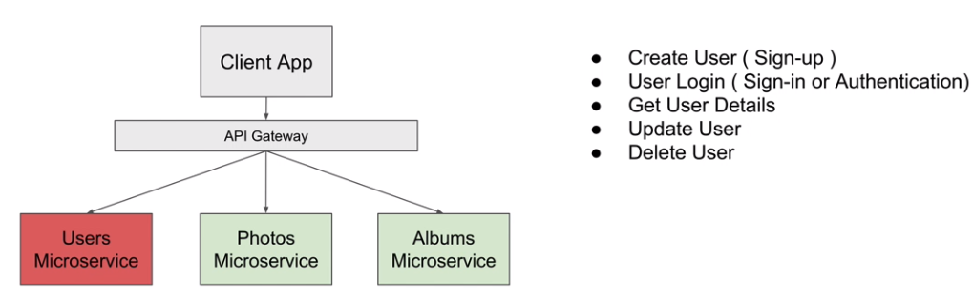

Slide 3
Adding method to handle HTTP Post Request

Slide 4
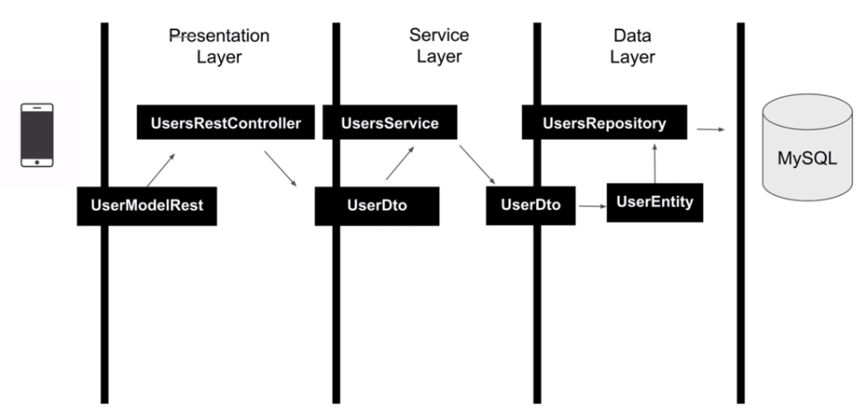

Slide 5
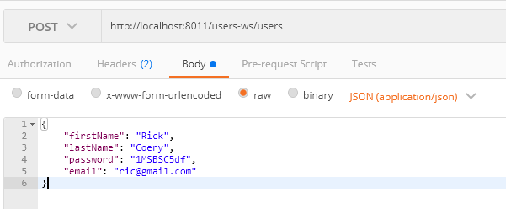
Accessing ‘User’ Microservice through Zull API Gateway Server
Or
http://192.168.0.5:8011/users-ws/users

Slide 6
Accessing ‘User’ Microservice H2 Console through Zull API Gateway Server
http://localhost:8011/users-ws/h2-console
Or
http://192.168.0.5:60360/h2-console
Eureka
http://localhost:8010/

